Slide 1
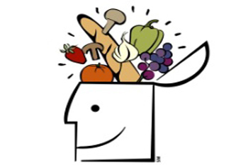
BRAIN FOOD
A recipe recommender system
By Corey Miller

Slide 2

The DATA
The goal is to minimize time and hassle at meal times by suggesting recipes based on ingredients.
A string of ingredients is input into the system and a list of 10 recipes generated from both similar and matching ingredients will be returned.
The recipe are returned in order of how well they matched the input ingredients.

Slide 3
The DATA
The system was built from an aggregation of multiple recipe databases :
Allrecipes.com
bbc.com/food/recipes
Epicurious.com
Cookstr.com
The final dataset used to build the system contained over 144K recipes!

Slide 4

The BRAIN
The true power behind the system is driven by a term frequency – inverse document frequency (TFIDF) matrix and supplemented with a word2vec model, both created from the recipe corpus.
The recipes were cleaned to prepare for the TFIDF matrix and word2vec model
Removed stop words
Removed punctuation and numbers
Removed most common non food words
Lemmatized
The TFIDF matrix was built and a word2vec model was trained on the corpus

Slide 5
The BRAIN
Ten keywords for each recipe were selected based on the highest TFIDF scores
Missing titles for recipes were filled with the top 3 keywords for that recipe
The rank order (score) for recipes returned is based on how well the input string matches the 10 keywords in each recipe
Most similar words to the input string are generated with the word2vec model
The word2vec model returns the most similar word from the word2vec vocabulary (when applicable) to each word input into the system
The most similar words are added to the input string to be fed into the system with the original string – increasing diversity of results returned

Slide 6
The BRAIN
Once a string is input into the system, matched with its most similar words, the new string of input and similar words is vectorized
The length of the input vector is the same length of the number of words in the TFIDF matrix
One hot encoding for each word that matches from the input to the TFIDF vocabulary
The TFIDF matrix is multiplied by the input vector and the top 10 highest scores are the results
The results are ranked by how well the original input matches the top ten keywords
A perfect score (1.00) represents a recipe who’s keywords contain ALL of the original input words

Slide 7

The RESULTS
The final system was tested with 3 different custom built tests
Test 1 = first 10 ingredients from n randomly sampled recipes
Test 2 = first 10 elements from cleaned text from n randomly sampled recipes
Test 3 = top 10 keywords from n randomly sampled recipes
The test was to use 1000 randomly sampled recipes with the inputs from each of the tests and measure the accuracy as how many times the inputs from a recipe returned itself
The accuracy results increased with each test
Test 1 = 53.2%
Test 2 = 53.1%
Test 3 = 100%
Test 3 performing with 100% accuracy makes sense because the recipes are generated based on how well the inputs match the TFIDF vocabulary and the top ten keywords are selected as the highest scoring TFIDF words for each recipe

Slide 8

Additional thoughts
Ratings were available for about 100K recipes
Attempted to use known recipes to build model to impute missing ratings
Ratings were to be used for secondary filtering, like the metric that was created
None of the models performed well enough to bring value to the system

Slide 9
Additional Thoughts
Clustering techniques (LDA, LSA, NNMF, etc.) to generate/find topics to allow for topic searching (i.e. Italian, Mexican)
Add a dithering algorithm to randomize the results returned
Allow for recipes to be added to the database
Further improve the recommender by using other techniques like collaborative filtering, especially if the ratings were available.
Get a website and go live!

Slide 10
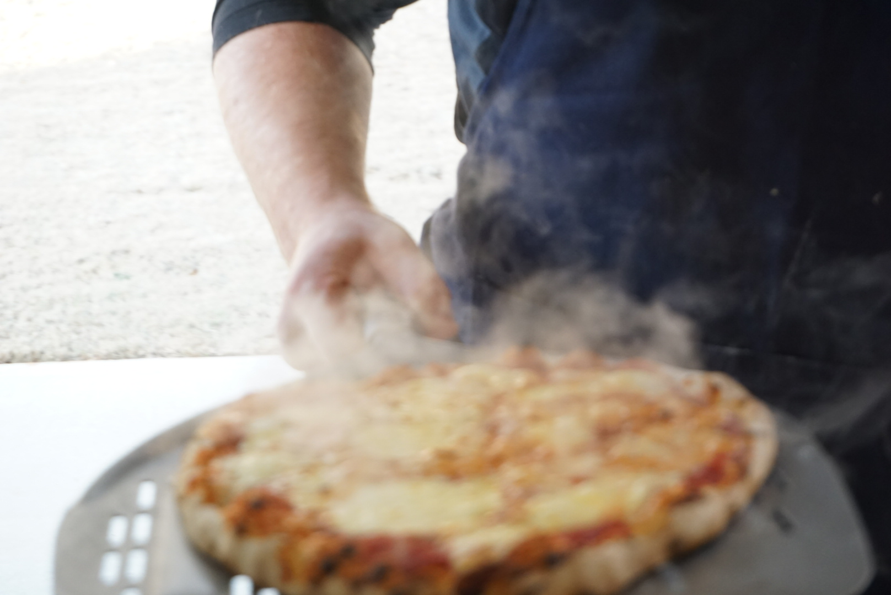
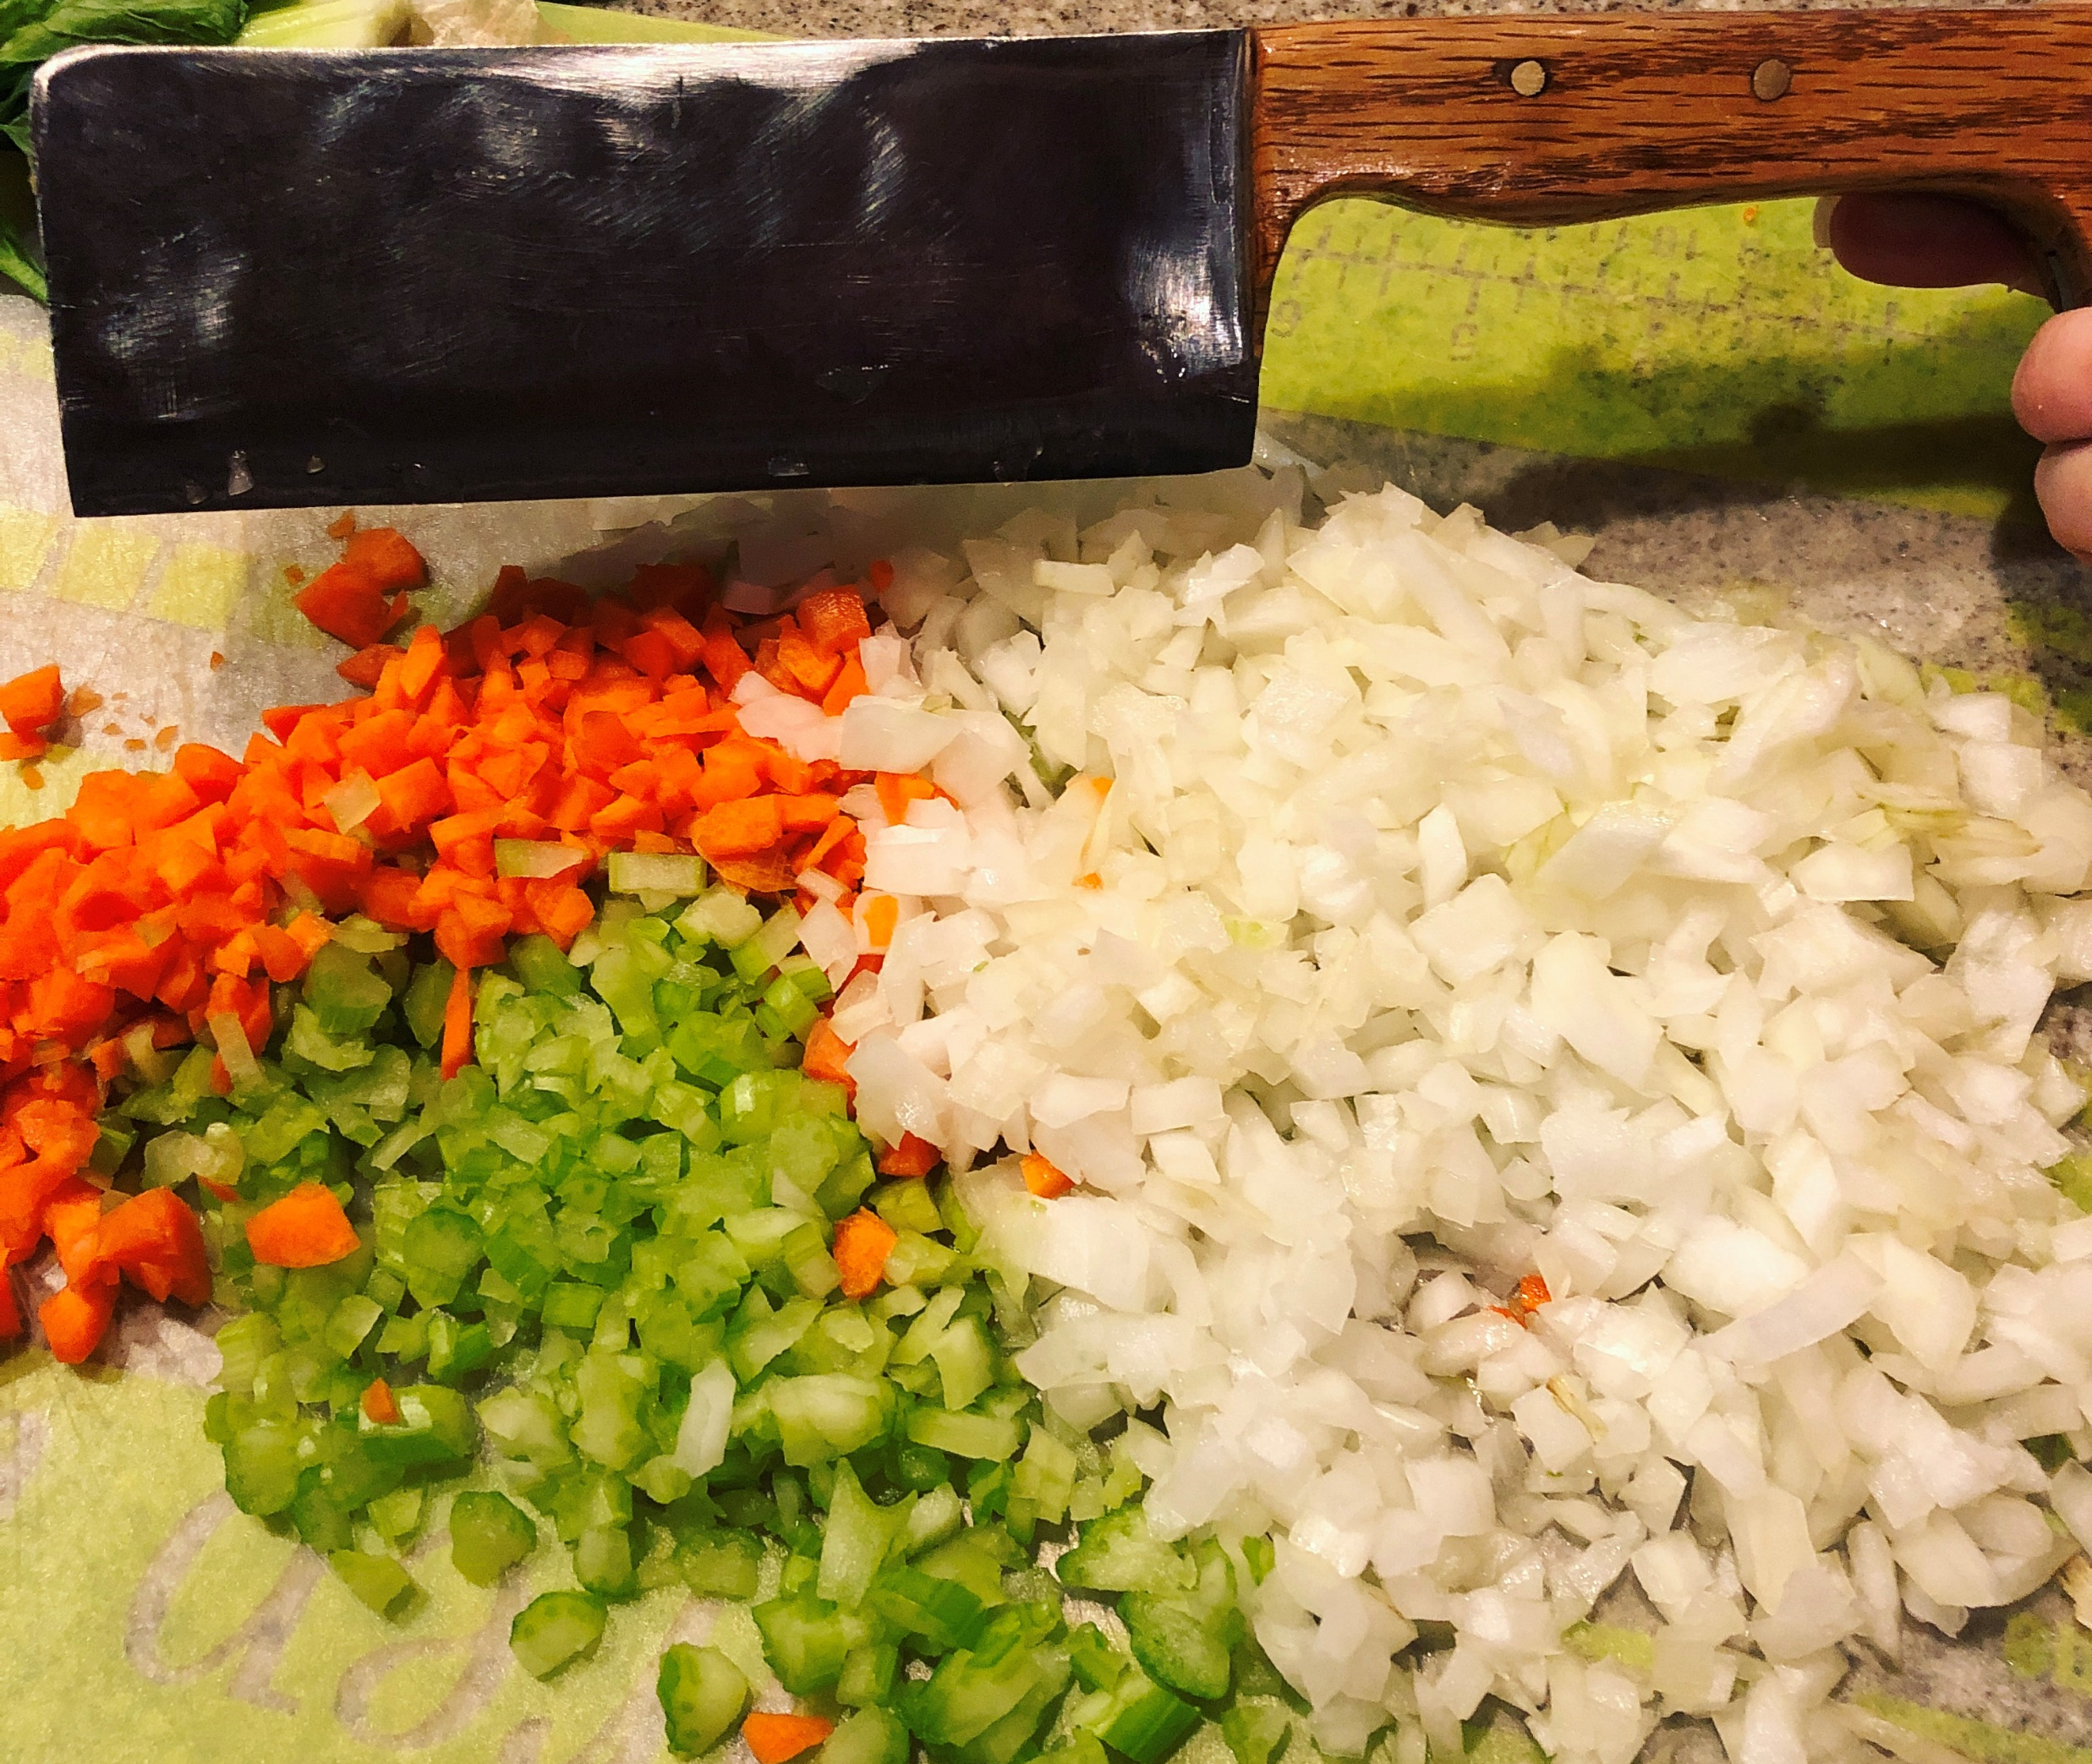
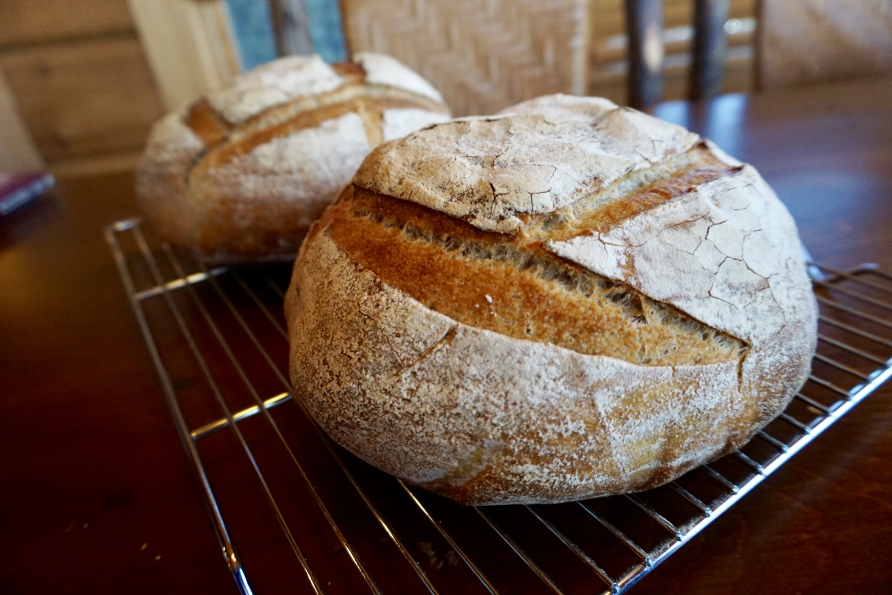
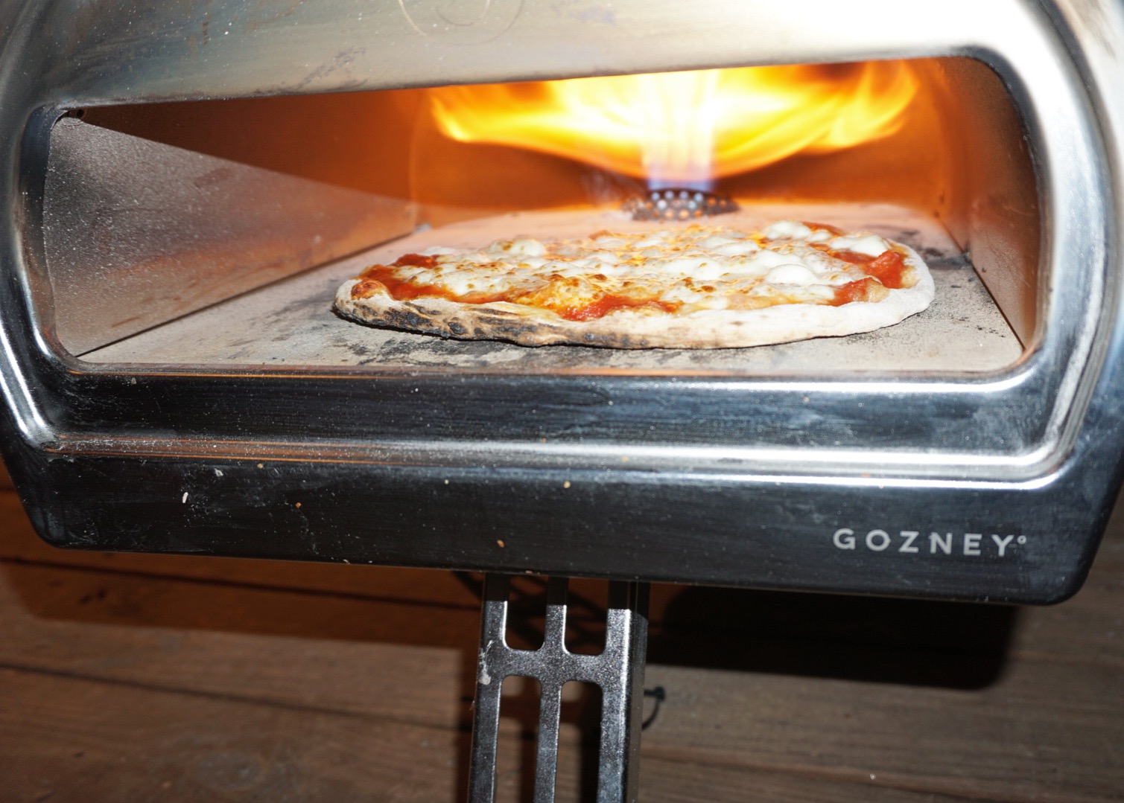
Questions and Examples

